Slide 1
Introduction to GIT
Jeffery Sauer
GIC
2019-01-31

Slide 2
Agenda
Introduction
Understanding why GIT is useful
Example workflows
Creating GitHub account / your first repository
Git installation and setup
Basic GIT commands to get you going!
A few specific commands
Questions/Troubleshooting/More learning/etc.

Slide 3
Introduction
GIT is an industry standard version control system (VCS) for tracking changes in code and files
Supports non-linear (i.e. branching) development if you need many versions to a given project
Free and open-source!

Slide 4
Understanding why GIT (and other VCS) is useful (1)
On large projects, we tend to start with a simple file.
Lastname_class_paper_v1.docx
By the time we get to the ‘final’ version a file, what might the name look like?
Lastname_class_paper_v9.docx
Lastname_class_paper_XYZedits_v9.docx
Lastname_class_paper_v9_XYZedits.docx
Lastname_class_paper_FINAL.docx
Lastname_class_paper_FINAL_FORSUBMISSION.docx

Slide 5
Understanding why GIT (and other VCS) is useful (2)
You may be using a type of version control without even knowing it!
Common file sharing programs with built-in version control:
Dropbox
Microsoft Exchange
Etc.
Any potential problems with these?

Slide 6
Understanding why GIT (and other VCS) is useful (3)
Lastname_class_paper_FINAL_FORSUBMISSION.docx
Complicated (and sometimes ‘unprofessional’) filenames
No readily useable identification information besides file name, save date, and file size
Risk of overwriting/erasing files
Dropbox and other file sharing programs
For single-user setups, dropbox pretty good!
However, for multi-user (shared) setups, no ‘master’ files – once someone saves a version, the previous is lost
VCS only for deleted versions, can’t iterate back through all saves

Slide 7
Understanding why GIT (and other VCS) is useful (4)
So why GIT?
Trust in our first filename
Unlimited undo/redo/saves/getting back previous versions
Keep a ‘master’ file while allowing others to branch on their own
Selectively allow changes
Easily share files through GitHub, promote open-access/reproducibility
Make use of workflows!

Slide 8
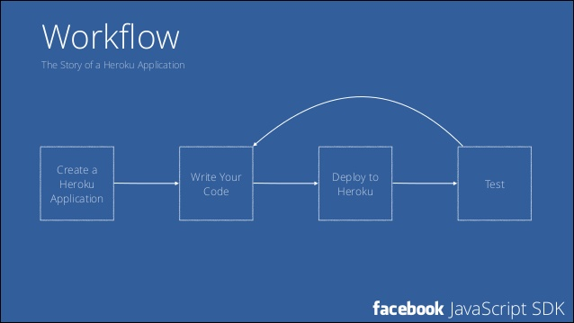
Example workflows (1)

Slide 9
Example workflows (2)
Workflows can be anything!
Check emails
Sit down at your computer
Prepare coffee
Work
Get food
Deal with unexpected colleague

Slide 10
Example GIT workflow (3)
What your (basic) GIT workflow might look like:
For an example writing Latex papers: https://medium.com/@rvprasad/a-git-workflow-for-writing-papers-in-latex-4cfb31be4b06
Download (pull) the most recent version of the folder to your own computer
Create a folder on your local computer
Work on contents until done for day
Upload the day’s version of the folder to GitHub

Slide 11
Creating a GitHub account (1)
Navigate to github.com
Pick a username
Pick an email
Create a password
https://www.random.org/passwords/?mode=advanced
Will need to confirm account via email
Ensure you can login to account without any warning/issue messages!

Slide 12
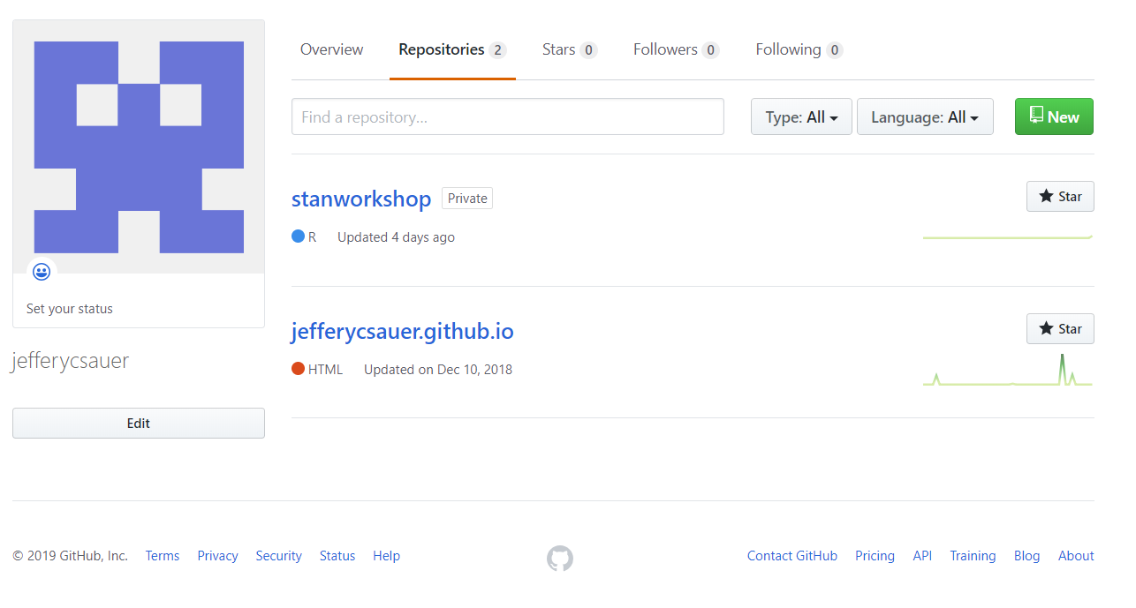
Creating a GitHub account (2)
Time to create our first repository!
A repository is a special type of folder where we will store our committed files
Navigate to your profile page (github.com/USERNAME?tab=repositories)
Click ‘New’

Slide 13
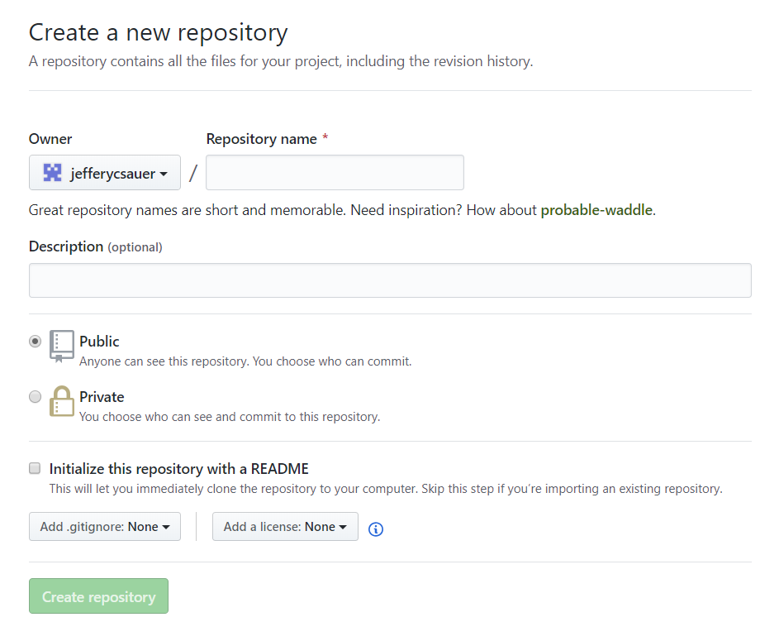
Creating a GitHub account (3)
Name the repository something short and straightforward
Ex. gic_git_2019
Set the repo to public or private (for our workshop it doesn’t matter!)
Don’t check the ‘Initialize … README’ box!
Click ‘Create repository’
Congrats!

Slide 14
10 minute break!
Take this time to make sure your account is working properly!

Slide 15
GIT snstallation and setup (1)
For windows: https://gitforwindows.org/
For MAC: https://www.atlassian.com/git/tutorials/install-git
For the GIC computers, simply navigate to the home menu and search ‘git bash’
This will open the git command line – welcome to your new ‘File’ dropdown menu! ☺

Slide 16
GIT installation and setup (2)
Now we need to setup our user identity
In the git command line type the following:
Always check these when switching computers (or after large software updates!)
$ git config --global user.name “YOUR NAME"
$ git config --global user.email YOUREMAIL@EMAIL.COM
$ git config –-list
$ git config user.name

Slide 17
GIT installation and setup (3)
Getting help in GIT
$ git help <ACTION I WANT TO DO BUT AM UNSURE HOW>
$ git help config

Slide 18
Basic GIT tasks for today
Commit
Push
Pull

Slide 19
Basic GIT tasks for today
Commit: ‘committing’ our changes to the record
Push
Pull

Slide 20
Basic GIT tasks for today
Commit: ‘committing’ our changes to the record
Push: ‘pushing’ our changes to the master branch/directory
Pull

Slide 21
Basic GIT tasks for today
Commit: ‘committing’ our changes to the record
Push: ‘pushing’ our changes to the master branch/directory
Pull: ‘pulling’ the most recent version of the branch/directory to our local machine

Slide 22
Basic GIT tasks: commit and push (1)
Create a folder on your desktop called gic_git_2019
Add a text file called ‘feelings.txt’ with the following sentences:
I am attending the GIC 2019 workshop on GIT.
Having a great time so far!
Save and exit the file/folder
This is going to be our test folder/file combination

Slide 23
Basic GIT tasks: commit and push (2)
Now that we have some files, we want to commit them to record
Where can we commit them…aha! Our GitHub repository.
This is a bit of a multistep process:

Slide 24
Basic GIT tasks: commit and push (3)
#Step 1: Change your directory toc the gic_git_2019 folder
$ cd C:/Users/js/Desktop/gic_git_2019
#Step 2: initialize the current directory as a GIT folder
$ git init
#Step 3: index and stage the files for your first commit
$ git add .
#Step 4: commit the staged files to the LOCAL repository
$ git commit –m “First commit message – customize this!”

Slide 25
Basic GIT tasks: commit and push (4)
#Step 5: Head to the repository you created on GitHub and
copy the repository URL
#Step 6: Add the copied URL as the remote (i.e. not on our
computer) repository where we want to put the files
$ git remote add origin URL
#Step 7: Verify that the copied URL is okay
$ git remote –v
#Step 8: Push the file to your GitHub account! You will
Be prompted for your GitHub username/password.
$ git push origin master
#What do ‘origin’ and ‘master’ mean here? Get help!
$ git help push

Slide 26
Basic GIT tasks: commit and push (5)
Check your GitHub account – are the files there?
Check the ‘status’ of the files in your local folder
$ git status
On branch master
Nothing to commit, working tree clean

Slide 27
Basic GIT tasks: commit and push (6)
What if our feelings about the workshop have changed? Return to the folder and edit the text file (to whatever you are feeling):
I am attending the GIC 2019 workshop on GIT.
It’s getting late and I am quite hungry!
Re-check the ‘status’ of the files in your local folder. What message do you see?

Slide 28
Basic GIT tasks: commit and push (7)
$ git status
On branch master
Changes not staged for commit:
modified: feelings.txt
No changes added to commit (use “git add” and/or “git commit –a”)

Slide 29
Basic GIT tasks: commit and push (7)
How can we commit these changes to the master branch?
We need to specify the files that have been changed/we want to commit.
Can either specify individual files ($ git add feelings.txt)
Or all files ($ git add .)
If you have good internet and project is not very large (i.e. greater than a couple gigabytes), I tend to default to $ git add . (NOTE: this is considered ‘bad practice’/inefficient in some professional settings. Reasons as to why?)
$ git add .
$ git status
On branch master
Changes to be committed:
modified: feelings.txt

Slide 30
Basic GIT tasks: commit and push (8)
Note that while we have committed the changes, we have only committed to our LOCAL git repository. We still need to push to our GitHub repository.
Check your GitHub website to see if the changes took place. Note the obvious benefit here: we have substantially changed our file without changing the name, while also retaining all previous versions!
$ git commit –m “Second commit – changed how I felt!”
[master d01a1e4] Second commit – changed how I felt!
1 file changed, 1 insertion(+), 1 deletion(-)
#Now push to our GitHub repository…
$ git push origin master

Slide 31
5 minute break!
Any questions?

Slide 32
Basic GIT tasks: pull (1)
Have you ever seen an interesting project and the associated link takes you to a GitHub repository?
In GitHub ‘lingo’, you pull repositories to your local machine.
This simplifies the data sharing process and maintains complex file structures.

Slide 33
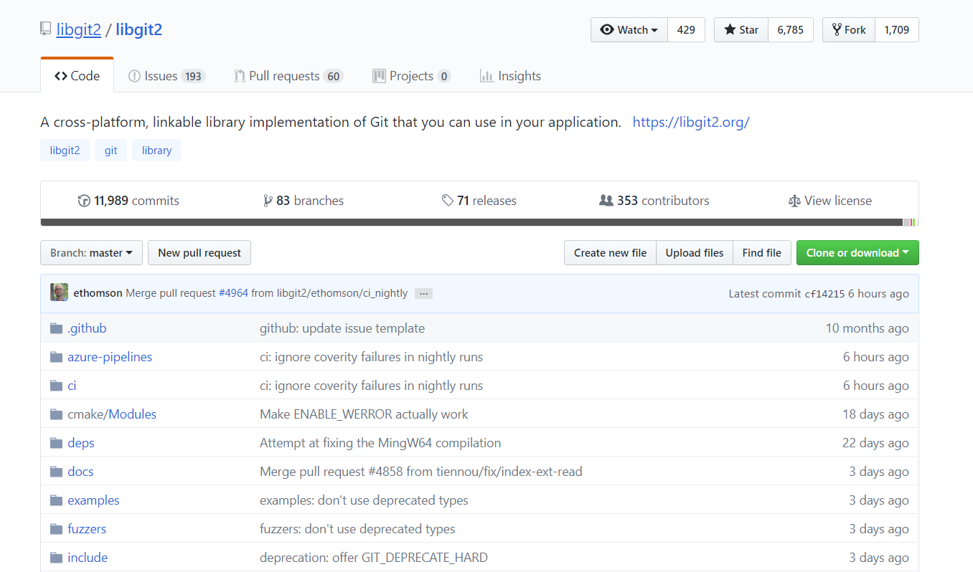
Basic GIT tasks: pull (2)
Let’s say we wanted to download these slides for future reference
We could find the repository hosting the slides on the instructor’s GitHub here: https://github.com/jefferycsauer/gic_git_2019.git
Click the ‘Clone or download’ button and copy the link

Slide 34
Basic GIT tasks: pull (3)
Now bring back up your git bash command line and enter the following:
$ git clone https://github.com/jefferycsauer/gic_git_2019.git
#We can also download it and put it in a different directory
$ git clone https://github.com/jefferycsauer/gic_git_2019.git C:/Users/js/Desktop/presentations

Slide 35
A few specific commands (1): viewing commit history
So long as you have pulled or are working in the master branch, you can view the history of commits by typing:
This is an extremely powerful command as any file changes (i.e. commits) require messages!
$ git log
# Or in one line format for many commits
$ git log –pretty=oneline

Slide 36
A few specific commands (1): viewing commit history
So long as you have pulled or are working in the master branch, you can view the history of commits by typing:
This is an extremely powerful command as any file changes (i.e. commits) require messages!
$ git log
# Or in one line format for many commits
$ git log –pretty=oneline

Slide 37
A few specific commands (2): unmodifying (i.e. undoing) a modified file
Return to our example of when we changed – but not yet committed – changes to the feelings.txt file
$ git status
On branch master
Changes not staged for commit:
modified: feelings.txt
No changes added to commit (use “git add” and/or “git commit –a”)
#To ignore changes for that specific file, use the following command:
$ git checkout --feelings.txt

Slide 38
Questions/Troubleshooting/More learning/etc.
Additional learning:
The GIT Book (FREE and VERY useful with lots of reproducible examples!): https://git-scm.com/book/en/v2/
GIT Presentation put together by McGIll PhD Student: https://aengusb.github.io/github_bootcamp/#/
Video (if you are more visually-oriented!): https://www.youtube.com/watch?v=HVsySz-h9r4
StackExchange guide for beginners: https://stackoverflow.com/questions/315911/git-for-beginners-the-definitive-practical-guide

Slide 39
Credits for many of the examples here…
The GIT Book and Aengus!

